Slide 1
Updates on
Pulse Stretching, Bigger Molecules and Errors
Meeting with Professor Schnetzer and Rikab
August 20, 2020

Slide 2
Pulse Stretching
Can’t get noise to work on pulse simulator in QIskit
have to use external libraries like Qutip (which Is for quantum optics simulations)

Slide 3
Loose Ends from Thermal Relaxation Errors
Difference between Thermal relaxation errors and depolarization errors, Doing error mitigation on LiH and BeH

Slide 4
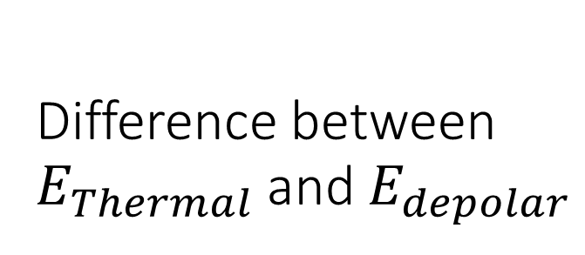
Difference between $E_{Thermal}$ and $E_{depolar}$
No answer
I don’t know what kind of errors E_depolar is trying to simulate
Over amplification seems likely because when we add in more gates (we are already amplifying thermal relaxation errors)
There is more going on behind the picture

Slide 5
Experiment on Lithium Hydride
Too many local hamiltonians -100 (Hydrogen only had 5)
Have to study the variational ansatz more in detail (UCCSD may not be really good for larger molecules in terms of gate scaling)
May try to do H3 and H4 instead

